Slide 1
Vodafone–VOIS Intelligent AI Assistant
CLIENT UPDATE · STEERING COMMITTEE
Project brief, status at Week 13, lessons learned and the decisions we need from you
Bipeen Sinha · Engagement Director
Shruti Sinha · Project Lead & Delivery Manager
15 Sep 2026
Notes:
Welcome everyone. Today we cover four things: a quick recap of the project brief, where we are at Week 13, what we have learned so far, and two decisions we need from the Steering Committee.

Slide 2
Four things to cover in 45 minutes
AGENDA
01
Project brief
02
Status at Week 13
Problem, scope, solution and roadmap
Schedule, cost, achievements, AI quality
03
Risks and lessons learned
04
Decisions and next steps
What is at risk and what we are changing
Two approvals needed today
VOIS AI Assistant · Client update · Week 13 of 21
Notes:
We will spend most of the time on status and the two decisions at the end.

Slide 3
A governed AI assistant for SAP, Oracle and QA knowledge
01 · PROJECT BRIEF
The problem
What we are building
The outcome
Application knowledge is scattered across wikis, SharePoint, tickets and experts. QA and IT support staff search by hand, answers vary, and SMEs answer the same questions again and again.
An assistant on Azure AI Foundry: GPT-5 and Foundry IQ answer from approved documents with citations, and read-only MCP tools query SAP, Oracle and QA test systems.
A security-reviewed pilot for about 150 users by 12 Mar 2027, targeting a 40% cut in lookup effort. It leads with a QA & Testing Assistant use case.
VOIS AI Assistant · Client update · Week 13 of 21
Notes:
Recap of the charter. The pilot is deliberately bounded: read-only tools, approved documents, non-production systems. Full enterprise rollout is Phase 2.

Slide 4
A bounded pilot: read-only, approved content, non-production
01 · PROJECT BRIEF
In scope
Out of scope (Phase 2)
Grounded answers with citations from ~1,200 approved documents
Read-only MCP tools: SAP, Oracle, QA test systems
Entra ID, role-based access, audit logging
AI security, evaluation, performance testing
UAT, pilot for ~150 users, training, handover
Write or transactional actions in any system
Confidential production data
Enterprise-wide rollout to all applications
Production hosting and 24×7 support
Changes to SAP or Oracle themselves
Budget ₹131.7 L incl. 10% reserve · Timeline 19 Aug 2026 – 12 Mar 2027 · Platform Microsoft Azure AI Foundry
VOIS AI Assistant · Client update · Week 13 of 21
Notes:
Scope is unchanged since the charter was signed. Any write capability or added application goes through change control.

Slide 5




How a question is answered, end to end
01 · PROJECT BRIEF
Foundry IQ knowledge
Approved documents
Hybrid search with security trimming
About 1,200, curated
Azure AI Foundry orchestration
Pilot users
Web chat UI
QA, IT support, business users
Entra ID sign-in and role-based access
GPT-5 reasoning, tool routing, answers with citations
MCP read-only tools
SAP, Oracle, QA tools
Every call authorised and logged
Non-prod, read-only
Platform: Key Vault · monitoring and tracing · audit logs · alerts · CI/CD dev → test → pilot
VOIS AI Assistant · Client update · Week 13 of 21
Notes:
Walk left to right. Users sign in with Entra ID; the orchestrator decides whether to retrieve from Foundry IQ, call a read-only MCP tool, or both; the answer comes back with sources. Nothing leaves the VOIS tenant.

Slide 6
Two gates passed; M3 is running one week late
02 · STATUS AT WEEK 13
Achieved
Achieved
At risk
In progress
Planned
M1 Architecture approved
M2 AI assistant MVP
M3 Application integrations
M4 Release candidate
M5 Pilot accepted
Weeks 5–8
Weeks 9–12
Weeks 13–16
Weeks 17–21
Weeks 1–4
Delivered 14 Dec, 1 day early
Baseline 14 Jan · forecast 22 Jan
Baseline 12 Feb · forecast 16 Feb
Still on track for 12 Mar
Signed off 16 Nov
VOIS AI Assistant · Client update · Week 13 of 21
Notes:
M3 slipped because Oracle sandbox access arrived about two weeks late. Phase 4 has absorbed most of it: M4 is forecast 2 working days late and M5 still holds at 12 March.

Slide 7
Overall AMBER: slightly behind, slightly over cost
02 · STATUS AT WEEK 13 · AS AT 15 JAN 2027
53%
0.94
0.96
complete vs 57% planned
SPI · schedule slightly behind
CPI · minor cost overrun
2 / 5
27 / 51
12 Mar
milestones achieved
activities complete
pilot acceptance still forecast
Earned value: PV ₹59.8 L · EV ₹56.4 L · AC ₹58.6 L · Source: Week 13 status log
Notes:
SPI and CPI are both just under our 0.95 threshold, which is why we are AMBER rather than GREEN. Neither is below the 0.90 escalation trigger.

Slide 8
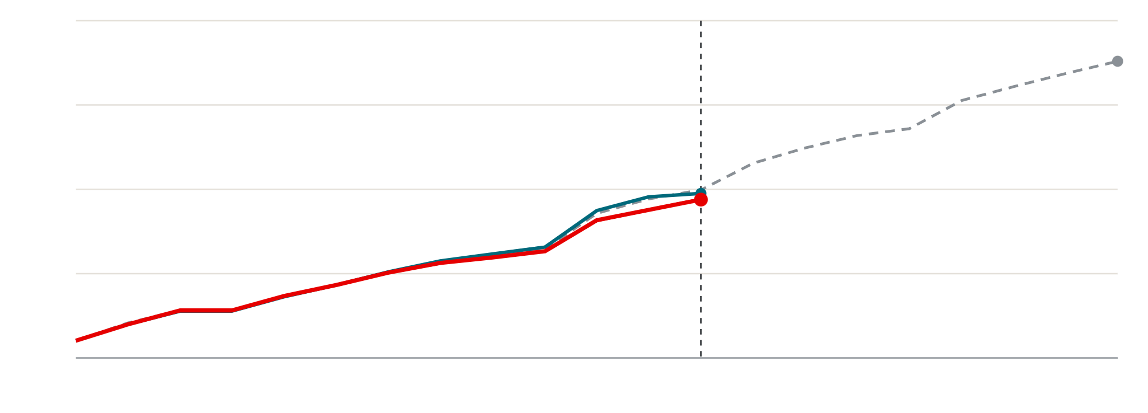
Earned value has tracked just below plan
02 · STATUS AT WEEK 13
₹120 L
Planned value (PV)
PV ₹105.6 L at Week 21
Earned value (EV)
90
Actual cost (AC)
60
AC ₹58.6 L
EV ₹56.4 L
30
Today · Week 13
0
W1
W5
W9
W13
W17
W21
Cumulative labour value, ₹ lakh · gap opened in Weeks 11–13 (holidays, Oracle delay) · SPI 0.94, CPI 0.96
Notes:
Until Week 10 earned value sat on the plan line. The gap opened in Weeks 11 to 13, when the holiday weeks and the Oracle access delay hit at the same time. Actual cost has run slightly above earned value since Week 7.

Slide 9
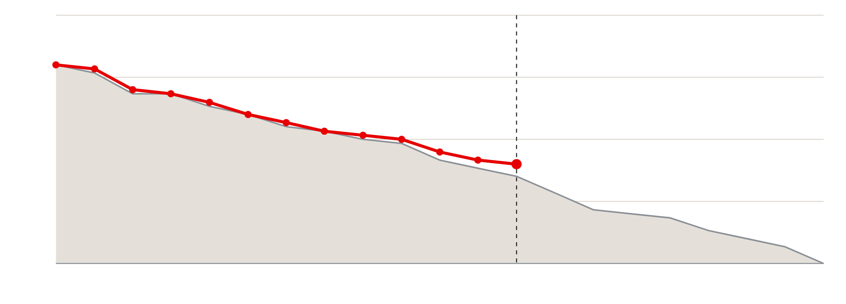
24 activities left against 21 planned
02 · STATUS AT WEEK 13
60
Planned remaining
Actual remaining
45
30
24 left · plan was 21
15
Today · Week 13
0
W1
W5
W9
W13
W17
W21
Activities remaining of 51 in the baseline WBS, by week
Notes:
Actual and plan moved together until Week 10. The three-activity gap is the Oracle integration, the resilience layer that depends on it, and the end-to-end tests.

Slide 10




What we have delivered so far
02 · STATUS AT WEEK 13
Architecture and security design approved by InfoSec and Enterprise Architecture (M1)
GPT-5 deployed in the VOIS Azure tenant; 1,240 curated documents indexed
AI assistant MVP live with grounded answers and citations (M2)
88% retrieval recall@5 on a 250-question benchmark, above the 85% target
SAP and QA connectors working end to end in non-production
P95 response 6.4 s at 50 concurrent users, inside the 8 s target
VOIS AI Assistant · Client update · Week 13 of 21
Notes:
Highlight the benchmark: we can now measure answer quality objectively every sprint, which de-risks the Month 4 evaluation gate.

Slide 11
Cost pressure sits in M3 integration
02 · STATUS AT WEEK 13
Budget
Earned value
Actual cost
23.7
23.7
24.0
22.2
19.9
17.0
17.0
17.3
17.3
17.9
16.3
2.2
2.2
0
0
M1 Discovery
M2 AI foundation
M3 Integration
M4 Security & QA
M5 Pilot
Labour, ₹ lakh, at 15 Jan 2027 · M3 earned ₹19.9 L for ₹22.2 L spent (CPI 0.90)
Notes:
M1 came in under budget and M2 slightly over. M3 is where the pressure is: the custom SAP wrapper and extra Oracle effort. M4 has only just started.

Slide 12
Integration work is 10% over cost; the reserve covers it
02 · STATUS AT WEEK 13
Phase (labour, ₹ L) | Budget | Earned | Actual | CPI
M1 Discovery | 17.0 | 17.0 | 16.3 | 1.04
M2 AI foundation | 17.3 | 17.3 | 17.9 | 0.97
M3 Integration | 23.7 | 19.9 | 22.2 | 0.90 · over
M4 Security & QA | 23.7 | 2.2 | 2.2 | 1.00
M5 Pilot & handover | 24.0 | 0.0 | 0.0 | –
Total | 105.6 | 56.4 | 58.6 | 0.96
Forecast at completion
₹109.7 L
₹4.1 L above labour budget
Management reserve
₹10.6 L
Untouched; covers the forecast gap
Earned value at 15 Jan 2027 · Azure and tooling billed at actuals, tracking to plan
Notes:
The overrun is concentrated in M3: a custom SAP wrapper and extra Oracle effort. Our recovery plan in Month 4 targets CPI back to 0.97 without touching the reserve.

Slide 13
AI quality: 4 KPIs met, 4 within reach
02 · STATUS AT WEEK 13
P95 response time
6.4 s · met
User satisfaction
4.2 / 5 · met
Retrieval recall@5
88% · met
Unauthorised access
0 · met
Tool-call success
95.5% · close
Answer groundedness
87% · close
Citation correctness
91% · close
Lookup effort reduction
32% · pilot
Bar = current value as % of target, capped at 120% · dashed line = target (100%) · teal = met, amber = below target
Notes:
Every KPI is at 80% of target or better. Groundedness and citations get a dedicated tuning sprint; lookup-effort reduction will be measured properly in the pilot.

Slide 14
AI quality: four KPIs met, four close to target
02 · STATUS AT WEEK 13
KPI | Baseline | Target | Current | Status
Retrieval recall@5 | 64% | 85% | 88% | Met
Unauthorised data access | – | 0 | 0 | Met
P95 response time | 11.2 s | ≤ 8.0 s | 6.4 s | Met
User satisfaction (1–5) | 3.1 | 4.0 | 4.2 | Met
Answer groundedness | 72% | 90% | 87% | Close · tuning
Citation correctness | 65% | 95% | 91% | Close · tuning
Tool-call success | 90% | 98% | 95.5% | Close · Oracle
Lookup effort reduction | 0% | 40% | 32% | Pilot will confirm
Measured on the 250-question benchmark and test environment · formal evaluation gate at M4
Notes:
Groundedness and citations get a dedicated tuning sprint (S7). Tool-call success will rise once the Oracle connector moves off the mock service.

Slide 15
Oracle access is the risk that matters most
03 · RISKS AND LESSONS LEARNED
Risk or issue | Rating | Response | Owner
Oracle sandbox access delayed ~2 weeks (issue) | High | Escalated to sponsor; mock service in use; M3 re-forecast to 22 Jan | Bipeen Sinha
Prompt injection or unsafe tool use | High | Read-only tools, Prompt Shields, red-team testing in Month 4 | Aditya Bose
GPT-5 quota limits load testing (issue) | Medium | Quota increase requested from Microsoft; tests throttled meanwhile | Farhan Qureshi
Groundedness below 90% at the M4 gate | Medium | Tuning sprint S7; citations enforced; weekly benchmark runs | Arjun Mehta
SME time for validation and UAT | Medium | UAT slots to be booked now for Weeks 17–19 | Shruti Sinha
Top 5 of 18 RAID items · full log reviewed weekly by the Project Lead
Notes:
Only two items are rated High. The Oracle issue is the one where we need sponsor help, covered in the decisions slide.

Slide 16
Lessons learned at the halfway point
03 · RISKS AND LESSONS LEARNED
What worked
What we would change
What we are doing now
InfoSec in design reviews from Week 2: no rework at M1
Benchmark built early, so quality is measured every sprint
Mock services kept integration moving while access was pending
Weekly earned value flagged the cost drift early
Third-party access should be on the critical path from Week 1
SAP effort was underestimated: legacy interfaces need a discovery spike
Model quota requests need weeks of lead time
Holiday weeks belong in the first baseline
Access tracker reviewed at every SteerCo
15% estimating buffer on each Phase 2 integration
Production quota requested 6 weeks ahead
UAT and SME slots booked now for Weeks 17–19
VOIS AI Assistant · Client update · Week 13 of 21
Notes:
These lessons also shape the Phase 2 estimate: integrations get a buffer and access requests start before mobilisation.

Slide 17
Two decisions we need today
04 · DECISIONS AND NEXT STEPS
1. Accept the M3 re-forecast
2. Sponsor push on Oracle licensing
Move the M3 gate from 14 Jan to 22 Jan. M5 pilot acceptance stays at 12 Mar. Alternative: descope the Oracle demo and keep 14 Jan.
Ask the Oracle DBA team to confirm sandbox licence approval by 20 Jan, so integration testing finishes inside Phase 4.
Next four weeks
Entra ID roles and authorisation · AI security red-team testing · groundedness tuning sprint · release candidate for the M4 gate on 16 Feb
VOIS AI Assistant · Client update · Week 13 of 21
Notes:
We recommend option 1: accept the one-week M3 slip. It protects the Oracle proof of concept and does not move the pilot date.

Slide 18
Questions and discussion
THANK YOU
Next Steering Committee: M4 gate review, 16 February 2027
Bipeen Sinha
Shruti Sinha
Rajesh Menon
Engagement Director
Project Lead & Delivery Manager
Executive Sponsor, VOIS
Notes:
Close by confirming the two decisions and the date of the next Steering Committee.

